Slide 1
LCSS
LOCAL Scholarships, bursaries, and awards 2026
School District No. 27
Lake City Secondary School
If you did NOT receive a personalized booklet, please see Ms. Gobolos in room #110 at the end of the day or as soon as possible!

Slide 2
If you are planning to attend any type of post-secondary education or TRADES training in 2026 or 2027, please watch this Power point presentation carefully!
The next few slides will review the process for applying for the local awards. Approximately $200,000 is available to those students pursuing many different kinds of post-secondary careers, including: nursing, engineering, carpentry, early childhood education, etc.

Slide 3
Even if you haven’t been accepted to a post-secondary institution (college, university, etc.) or even applied to a post-secondary institution, you can apply for these local scholarships/bursaries!
However, if you are awarded a scholarship or bursary, you will not be able to claim your award unless you have registered for some sort of post-secondary education and you have paid tuition.

Slide 4
Wednesday
February 4th
2026
Your Scholarship/Bursary APPLICATION FORM and COVER LETTER are due to Ms. Gobolos on or before 3:30 pm on February 4th. You MUST hand in your package to Ms. Gobolos! Please give it directly to her.

Slide 5
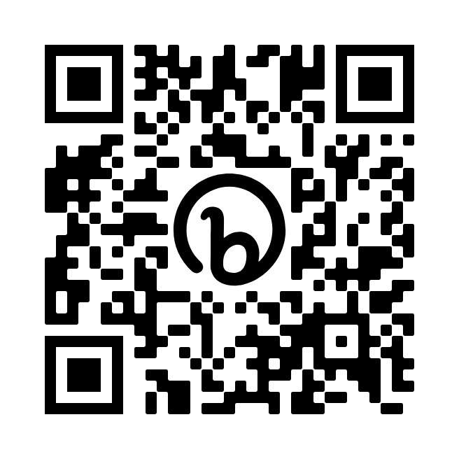
The scholarship/bursary handbook can also be found on the website, “Science and Scholarships with Ms. Gobolos”.
If you misplace your booklet or require another application form, please visit the website or find Ms. Gobolos in room #110. You can also e-mail her at jeannette.gobolos@sd27.bc.ca

Slide 6

https://jeannettegobolos.wixsite.com/jeannette-gobolos

Slide 7
How to apply
Complete the Lake City Secondary Scholarship and Bursary Application Form (last page in your booklet)
Write a ONE page single-spaced cover letter (typed in size 11 or 12 font)
AND
You may choose to complete the essay topic(s). The essay(s) must be included in your application package and submitted directly to Ms. Gobolos on or before February 4, 2026.

Slide 8
One application form and one cover letter are all you need to apply for all the local scholarships!
The essays are optional.

Slide 9
Scholarship cover letter
You should include the following information in your one-page cover letter:
PERSONAL - family, places of residence, schools attended, and school & community experiences (e.g. clubs, sports, hobbies, special talents, etc.)
ACADEMIC - educational experiences, school program, post-secondary intentions, career choice(s)
FINANCIAL - brief estimate of expenses, support from parents, work experiences, personal savings, etc.

Slide 10
You may use the template provided or create your own cover letter
Many donors appreciate originality!

Slide 11
January 5, 2026
Anita Scholarship
640 Carson Drive
Williams Lake, BC
V2G 1T3
Dear Members of the Scholarship Committee:
After reviewing the School District No. 27 Scholarship and Bursary Handbook, I am excited to realize that I meet the criteria for several of the awards. My goal is to attend [post-secondary institution] in the fall to obtain [degree? diploma? certification?].
Academically, I am a [very talented student? satisfactory student?]. I have done [exceptionally well? satisfactorily?] in all of my grade 11 and 12 courses [honor roll? work ethic?]. I am [dependable, adaptable and have a strong work ethic] [evidence?]. My academic achievements are not the only factors that make me a qualified candidate for School District No. 27 scholarships and bursaries. I am active in my school community as an [integral member of the rugby program? tour band? leadership?]. I also volunteer with the [Williams Lake Big Brothers and Sisters organization as a teen mentor] [which shows? which requires?]. In addition, I have a passion for [sports and the outdoors]. I love to [ski in the winter and play soccer and kayak in the summer]. Furthermore, I am [the captain of the WLMHA midget rep hockey team] [which shows?] and I really enjoy [reading, knitting, yoga, and painting].
I am estimating that I will spend approximately [$20,000] during my first year of post-secondary studies. [My job has provided me with some funds and my parents will also help me financially]. Thank you for your time and consideration and I hope that you will help support my plan to attend post-secondary with a local scholarship or bursary. A scholarship and/or bursary will assist in paying my tuition at [?].
Sincerely,
Anita Scholarship
Anita Scholarship
Please format your letter appropriately. If you require assistance to write your letter, please see Ms. Gobolos!
To format your letter, follow the steps below:
open a WORD document
choose the “No Spacing” option on the task bar
press ENTER 7x (may be reduced if space is an issue)
type the date
press ENTER 4x
type your name and return address
press ENTER 2x
type “Dear Members of the Awards Committee:”
press ENTER 2x
type the rest of your letter
type “Sincerely,” then ENTER 4x
type your name and add your signature
Tailor the letter to fit your circumstances. Put your individual information into the [ ].

Slide 12
The essay topics are NOT mandatory. However, if you choose to complete one or more of the essays, they are due with the rest of your application package on or before
February 4th, 2026.

Slide 13
Essay Topics - Optional
1. Cariboo Regional District Bursary (1 @ $1000)
A bursary will be awarded to a graduating student who is pursuing post-secondary studies towards a career in local government (e.g. public administration, planning, bylaw enforcement, engineering, communications or environmental studies). THE SUCCESSFUL CANDIDATE MUST BE LOOKING TO BUILD A CAREER IN LOCAL GOVERNMENT or POLITICS. Students applying for this bursary must maintain a minimum of a B average throughout their senior year, and complete a 500 word ESSAY about their future studies and how it will be incorporated into a career in government.
2. Cariboo Woodlot Education Society Bursary (2 @ 250)
These bursaries will be awarded to a graduating student who is intending to pursue a career in Natural Resources Management (Forestry, Fish & Wildlife, or Conservation) at a BC Post-Secondary Institution. Candidate students must respond to either of the following topics in 500 words or less:
Which aspect of Natural Resource Management do you intend to focus on and why it appeals to you?
Any current natural resource management issue that sparked your interest in this career path, and why it is important to you.
3. Danielle Helmer Memorial Athletic Scholarship (1 @ 1000) - not awarded every year
The Danielle Helmer Memorial Athletic Scholarship is given to a female student who is involved with school sports and is a positive influence on the school community. Danielle Helmer was a Columneetza student athlete who received amazing support from her teammates during her illness. Female students who wish to apply for this award must write an essay about the positive impact that school sports have had on their high school career and the skills that they have developed as a result of being involved.

Slide 14
4. Royal Canadian Legion Bursary (2 @ 1000)
The Royal Canadian Legion Bursaries are given to GRADs who have a familial association with the Legion, military or RCMP. In order to assist the Legion in making informed choices, all students applying for these bursaries MUST explain (with a paragraph) their familial association to the Legion. Once familial affiliation is established, the Legion will use the following criteria to select their recipient… - academic standing - athletic participation - connections to other organizations - financial need
5. UNIFOR Bursary (5 @ 2000)
The GRAD must be a child of or in care of a UNIFOR Local 3018 member that is in good standing. The applicant must be planning to enroll in full-time post-secondary education. The successful recipients will have the option of deferring the award for up to one year. A 250 – 500 word submission must be provided explaining why the bursary is important to you, how it will be used, what your career goals are, and what you have done and plan to do to achieve these goals. In addition, the following must be provided on the paragraph/essay: full name of applicant, address, phone number, e-mail address, and name of the related UNIFOR member.
6. West Fraser Mills Ltd. Woodlands Bursary (3 @ 1000)
To be eligible for the bursary, one must be one of the following …
An Indigenous student pursuing a post-secondary education
The son or daughter of a West Fraser Mills Ltd. Employee or direct business partner
Entering a Forestry or Trades Program that supports the forest industry
In addition to meeting one of the above criteria, to be eligible, one must write a paragraph explaining post-secondary plans and a reason(s) behind this decision. A copy of the latest report card must also be included. Additionally, when you receive your report at the end of semester#1, please bring a copy to Ms. Gobolos so it can be included in your application package.

Slide 15
7. Williams Lake Minor Hockey Association Scholarship (2 @ 500)
To be eligible for the award, you must provide a paragraph (100-150 words) on what your experience in WLMHA has meant to you and how you have given back to the sport in a meaningful way. In addition, you must include a reference letter from a WLMHA coach, manager, board member, etc.
8. Taseko Gibraltor (2 @ $1500)
Scholarships will be awarded to two graduating students who are enrolled in post-secondary education in engineering, sciences, environmental studies or a trades program. To be eligible, provide a brief (250-300 word) explanation on why you selected this career path, why it is important to you, and what unlocking true value means to you. Please include how you are affiliated to Taseko or Gibraltor (parent, grandparent, or guardian).
9. Williams Lake Ladies Soccer Association (1 @ $500)
A scholarship/bursary will be awarded to a student(s) who is currently involved with the Williams Lake Ladies Soccer Association (winter and/or summer). To be eligible, provide a brief (250-500 word) explanation covering the following:
how you are involved or will be involved with the WL Ladies Soccer Association
your contributions to the sport (e.g. player, referee, coach, assisting with camps, etc.)
your future plans with regard to soccer (e.g. post-secondary institution player, WLYSA coach, continue playing with the WL Ladies Soccer Association, etc.)
what playing soccer means to you / how it has helped you develop

Slide 16
10. Sugar Cane Archaeology (1 @ 1000)
A bursary will be awarded to a graduating student who is pursuing post-secondary studies towards archaeology, anthropology , or Indigenous studies. To be eligible for the bursary, you must provide an essay on why you selected one of these fields, where your passion for archaeology, anthropology, or Indigenous studies comes from, what you’re hoping to achieve, and what your career in this field could look like.

Slide 17
When Completing the Application Form …
use a blue or black PEN to legibly complete the form! DO NOT USE PENCIL!
use your legal name on the form
include your SIN (social insurance number)
  if you don’t have one, please apply for one ASAP
include your PEN (provincial education number)
  can be found on MyEd, on your report cards, from a counselor, or Ms. Gobolos
your mailing address must include the city and postal code
please ensure that you have included at least one potential career
include the full name of parent(s)
sign the bottom of the form and have a parent/guardian sign as well
complete the CHECKLIST with a parent/guardian

Slide 18
School District No. 27 Scholarships and Bursaries
LCSS Application Form 2026
Last Name ______________________________ SIN ____________
First Name ______________________________ Birthdate ____________
PEN Number ____________
Mailing Address ______________________________________________________
______________________________________________________
______________________________________________________
______________________________________________________
Telephone _______________ Cell phone __________________
e-mail ___________________________________________________
Career Intentions (if undecided, list a couple of choices)
blue or black pen ONLY (no pencil)
legal name
SIN must be included
PEN must be included
mailing address must include city and postal code
include at least one potential career
Post-Secondary Institution you plan to attend (rank in order of importance!)
________________________________________
________________________________________
________________________________________
include full name of parent(s)
include student signature
include parent signature
Father’s name _________________________ Mother’s name ______________________
Occupation _________________________ Occupation ______________________
Employer _________________________ Employer ______________________
By signing this form, I am authorizing my school to release my grades to the Williams Lake Scholarship Committee
f or the purpose of determining scholarship distributions.
Student Signature: _____________________________ Parent Signature : ____________________________

Slide 19
Checklist
Elementary School(s) Attended: ____________________________________________________________
First Nations Ancestry r Band Name ______________________________________
Leadership at LCSS r
Resident of Likely r
Resident of Horsefly r
Resident of Big or Beaver Lakes r
Please complete the checklist with a parent or guardian!

Slide 20
USE BLUE OR BLACK INK WHEN COMPLETING THE APPLICATION FORM
(NOT PENCIL)

Slide 21
The awards that require affiliation are only a small portion of the scholarships/bursaries available. So, even if you don’t “check” any of the boxes on the application form, there are many local awards available!

Slide 22
Even if you are taking a ‘gap’ year, please apply!
Most donors allow you to defer your award for one year and sometimes even two!

Slide 23
One application form and one cover letter are due on or before February 4th, 2026
@ 3:30 pm
If you have chosen to write an essay or essays, they are due with your application form and cover letter

Slide 24
If you have any questions, please see ms. Gobolos in room #110 at any time or e-mail her at jeannette.gobolos@sd27.bc.ca

Slide 25
Please give your application package directly to Ms. Gobolos in room #110. do not give it to anyone else!

