Slide 1
School District #27 Lake City Secondary
Scholarships, Bursaries, and Awards

Slide 2
Congratulations!
You have received a School District NO. 27 scholarship, bursary, or award
Please view the following power point presentation (also posted on my website)
If you still have questions, please e-mail me at … jeannette.gobolos@sd27.bc.ca

Slide 3
Thanking your donor
you must thank your donor (before the end of summer)!
  At the bottom of your scholarship letter, you will see an address
  If there is only one address, BOTH your thank you card and Tuition Fee Receipt go to that address
    Address: Alexis Creek Community Bursary
c/o Laurel McKay
PO Box 195
Alexis Creek, BC
V0L 1A0
  If there are two addresses, then please send your thank you card to one address and your tuition fee receipt to the other
Thank you Address | Fee-Receipt Address
Atlantic Power | Lake City Secondary School
c/o Frankie Nelson | c/o Jeannette Gobolos
Mail Bag Service 1000 | 640 Carson Drive
Williams Lake, BC V2G 4R7 | Williams Lake, BC V2G 1T3

Slide 4

Thank you card
Purchase a thank you card … (Below is an example of what can be written inside the card)
Dear Donor:
Thank you for the scholarship. I am planning to pursue a career in teaching and will be attending UNBC in the fall.
Sincerely,
Anita Scholarship
Don’t forget to make sure you are using the correct form and spelling of the person’s name.
If you have an extra GRAD photo, please include it in the card.

Slide 5
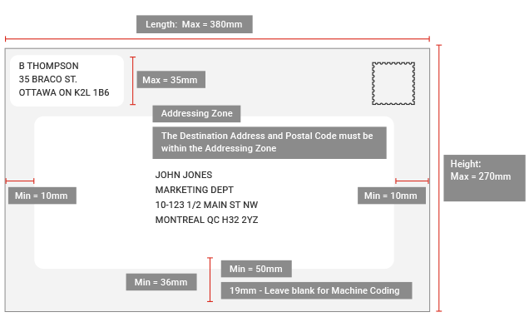

How to address an envelope
Please write your address in the top left-hand corner of the envelope
Place the stamp in the top right-hand corner of the envelope
Write the address of your donor in the middle of the envelope, leaving space around all four sides
your address
address of your donor

Slide 6
Tuition Fee Receipt
In order to redeem your award, you must send a tuition fee receipt to the address on the bottom of your scholarship letter! to receive a tuition fee receipt, you must have paid your tuition!
The tuition that you have paid must be equal to or greater than the amount of your scholarship
The donors will not pay for anything other than tuition! (there are some special circumstances, so if you have questions, please contact ms. Gobolos)

Slide 7
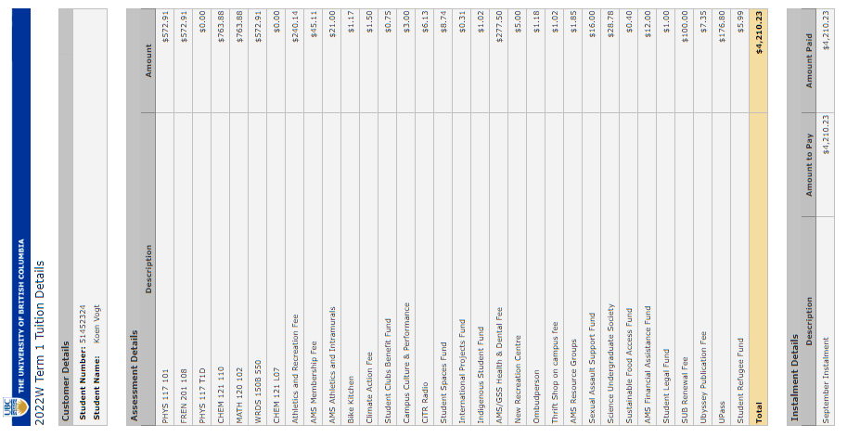
Sample Tuition Fee Receipt

Slide 8
If there is just one address on the bottom of your scholarship letter, then both the thank you card and the tuition fee receipt are sent to the same address
If there are two addresses, then please send the thank you card to the “thank you address” and the tuition fee receipt to the “Fee Receipt address”

Slide 9
Award Deferral
If you are not planning to attend a post-secondary institution in the year immediately following your graduation, please indicate that you would like a one year deferral in your thank you CARD
Most scholarships, bursaries and awards only allow a one year deferral
If you would like to defer for a longer period of time, please contact your donor!

Slide 10
District Authority Awards
If you received a District Authority award, please visit the website on your letter and follow the instructions! The voucher doesn’t normally arrive until the end of October at the earliest.
There is no need to send a thank you card to the BC Ministry of education!

Slide 11
Timeline
You must thank your donor by the end of september!
It is okay to send the thank you card and the tuition fee receipt at the same time!

Slide 12
Time to receive your reimbursement cheque
Please allow 6 – 8 weeks from the time you send your tuition fee receipt to the time that you receive your reimbursement cheque
If it seems to be taking a long time, please give me a call (250-392-6284) or e-mail jeannette.gobolos@sd27.bc.ca

Slide 13
Questions or concerns
If you have any questions, please call 250-392-6284 OR e-mail me at …
jeannette.gobolos@sd27.bc.ca
UNFORTUNATELY, THE SCHOOL IS CLOSED FROM JULY 1, 2025 TO AUGUST 25, 2025. IF YOU SEND ME YOUR TUITION FEE-RECEIPT DURING THAT TIME, I WILL NOT BE ABLE TO PROCESS IT UNTIL THE BEGINNING OF SEPTEMBER.

